Slide 1
The Learning Excellence and Innovation Department (LEID) welcomes you to Northern College!

Slide 2
Who are we? (in 5 minutes or less!)
The Learning Excellence and Innovation Department (LEID) is positioned in the Academic Division at Northern College and provides operational leadership in support of a variety of projects related to quality assurance, teaching and learning.

Slide 3
We are guided by our Academic Plan
Northern’s Academic Plan
Graduates and Students
Educational Philosophy
Faculty Development

Slide 4
Guiding Principles…
Quality Learning Experiences
360⁰ Student/Graduate Support
Exemplary Instructional Methodology
Continuous Faculty Development

Slide 5
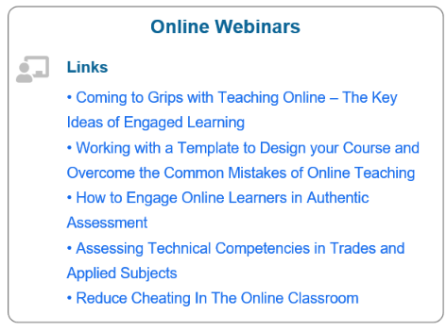
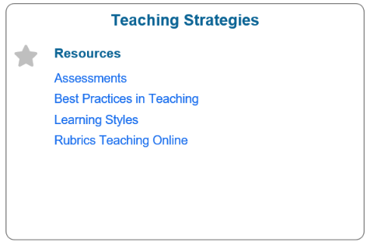
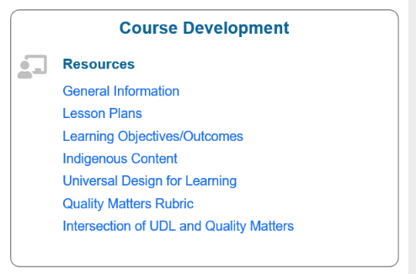
Areas of Support

Slide 6
Learning Excellence & Innovation Department also supports Northern's Digital/Technology – Enhanced Learning Strategy
Ease of Use
Technologies, tools, resources, and design will be intuitive, valuable, and simple, with a goal of ultimately becoming transparent in the learning process.
Student-Centered
Learning is dynamic and use of tools, technology and design may change and develop as student needs are revealed and newer technologies become mainstream.
Evolving
Effective digital design and engagement is not a one-size fits all approach. All choices will be informed through the lens of student success and engagement.

Slide 7
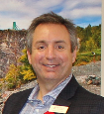
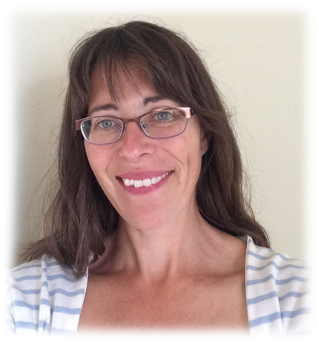
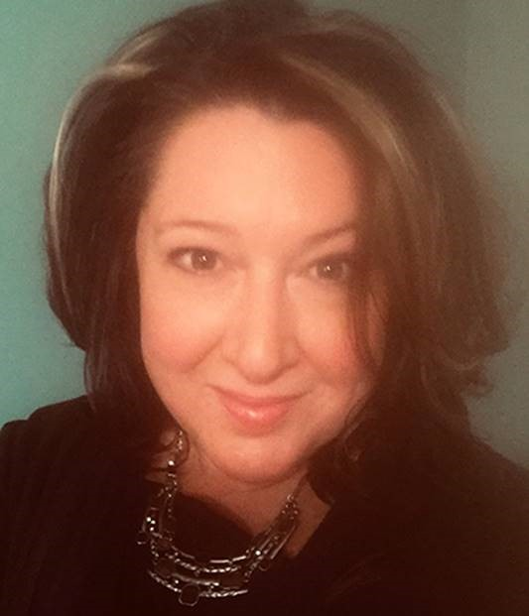
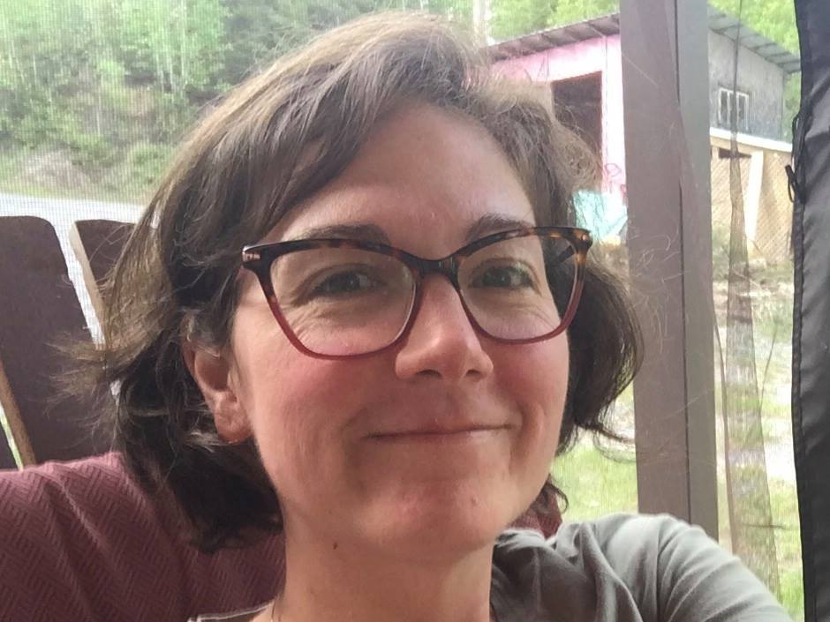
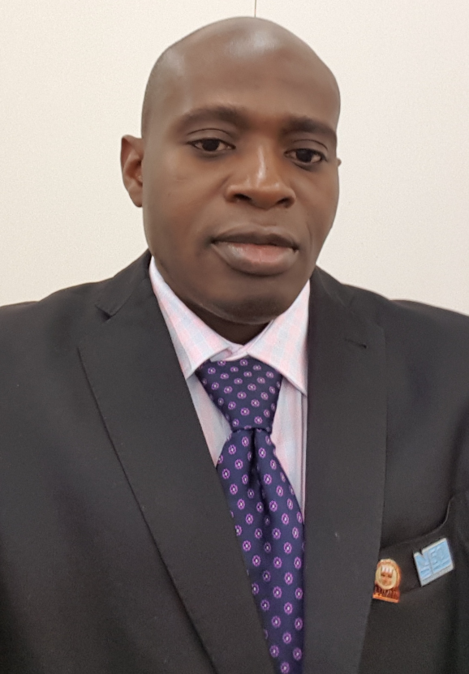
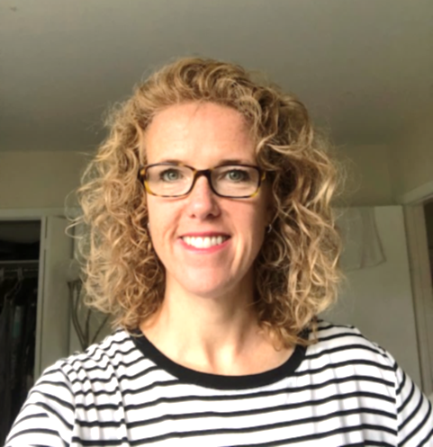
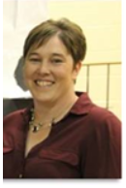
Meet the LEID Team!

Slide 8
Dean Lessard Dean of Community Services and LEID
Timmins Campus
lessardd@northern.on.ca

Slide 9
Emily Disley Program Assistant -Community Services and LEID
Timmins Campus
disleye@northern.on.ca

Slide 10
Lance Males Faculty
Timmins Campus
malesl@northern.on.ca

Slide 11
Kayode Arowolo Faculty
Timmins Campus
arolowo@northern.on.ca

Slide 12
Jennifer Huggins Faculty
Timmins Campus
hugginsj@northern.on.ca

Slide 13
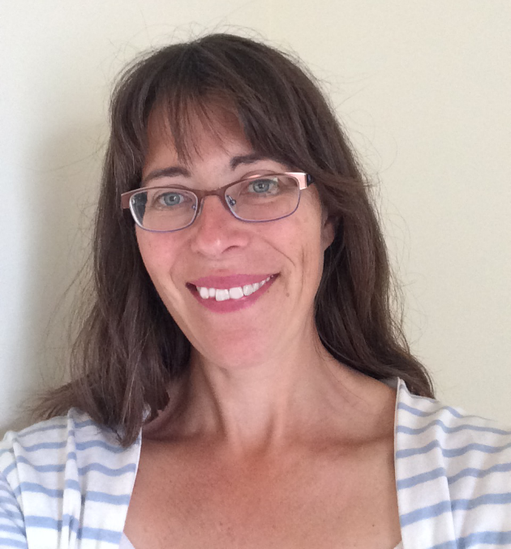
Janna Duval Instructional Designer
Haileybury Campus
duvalj@northern.on.ca

Slide 14
Angela Bourgeois Audio Video Systems and Learning Technologist
Timmins Campus
bourgeoisa@northern.on.ca

Slide 15
Shannon Johnston Educational Applications Systems Analyst
Timmins Campus
Johnstons@northern.on.ca

Slide 16
Shannon Arsenault Senior Library Technician
Timmins Campus
arsenaults@northern.on.ca

Slide 17
Stay tuned…
Weekly “New at Northern Bulletin”
Monthly PD opportunities
-in-house
-through MCCM (Multi-College Collaboration Model)
Information Sharing

Slide 18
Contact us!
leid@northern.on.ca

Slide 19
Universal Design for Learning - An Introduction

Slide 20
Today's Session
1. What is UDL?
2. Why UDL at Northern?
3. The UDL Principles
4. How can I get started?

Slide 21
The history of UDL
UDL is the acronym for Universal Design for Learning
UDL comes from the architectural design principles of Universal Design (UD). This principle was created to try to reduce barriers and increase access for all the “built” world.
UDL was often referred to as UID.

Slide 22
UDL is making education more accessible for ALL.
Universal Design for Learning (UDL) is a research-based framework for designing curricula—that is, educational goals, methods, materials, and assessments—that enable all individuals to gain knowledge, skills, and enthusiasm for learning. This is accomplished by simultaneously providing rich supports for learning and reducing barriers to the curriculum, while maintaining high achievement standards for all students.

Slide 23
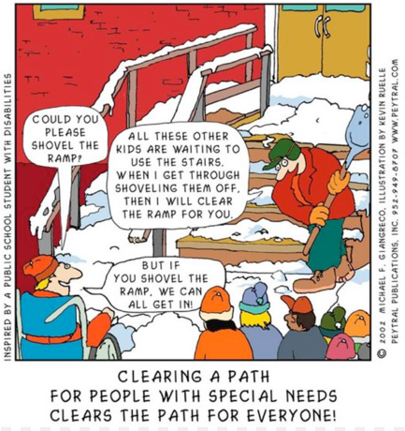

Slide 24
UDL considers barriers for students and attempts to reduce or remove them.
What are some barriers to consider?

Slide 25
Barriers to learner success

Slide 26
Barriers to learner success (Personal)
Health
Finances
Sleep
Culture
Commute
Previous experience
Age
Language skills
Support
Access to technology
This Photo by Unknown author is licensed uder CC BY-SA.
Notes:
How could you support your students with these barriers?

Slide 27
Course Design Barriers
Inflexible deadlines
Written assignments
High stake assessments
Limited choice on materials
Limited representation of diverse voices
Participation requiring oral communication

Slide 28
Notes:
When I think

Slide 30
Examples:
Help students to understand the relevance of the topic (why are we learning this?)
Foster collaboration and a sense of community
Consider self-review, self assessment, and reflection
Notes:
What’s the point? How is this going to help me in my career?
Community – group work is a challenging thing – make it voluntary for bonus marks….students set up a Facebook group
Self-reflection – after an oral presentation I ask students to submit a self reflection on what went well, what didn’t….students on placement I do the same thing.

Slide 31
Examples:
Provide different ways for sharing the information (textbook, powerpoint, video, weblink)
Providing a variety of assessment methods (oral presentation, short answer, MC etc.)
Offer alternatives for auditory or visual information (transcripts etc.)
Notes:
MS teams has transcript…Youtube has transcript but also option to slow down the speed

Slide 32
Examples:
Allow multiple formats for demonstrating knowledge—oral or written
Provide options for student responses (video, audio etc.)
Encourage use of technologies to ensure students accurately express their understanding
Notes:
Oral presentation assignment – live with camera or without, pre-record and show class, pre record and just show faculty, or one on one

Slide 34
Quick tips!
Present information in a multiple formats, including text, graphics, audio, and video.
Post lecture outlines (not necessarily complete notes) prior to class, which students can use as a framework for note taking.
Provide instructions for assignments both verbally and in writing.
Communicate high expectations for all students, while expressing your willingness to make “appropriate accommodations” for students with disabilities.

Slide 35
Provide ample time for online assignments to allow for technical malfunction.
01
Create a welcoming class environment. Learn students' names, if possible, and use their names when calling on them. Arrive early to class and greet students as they enter. Stay a few minutes after to take questions.
02
Offer office hours in flexible formats: face-to-face, email, telephone, etc.
03

Slide 36
UDL - It’s just about being a good human!

Slide 37
Any questions?

