Slide 1
Finding the Cadence of your Course
Tammy Soanes-White
Center for Learning and Teaching Innovation (CLTI)
Aurora College

Slide 2
Today’s Plan
What is cadence?
Why does it matter?
How can we use it to improve learning conditions
Make learning memorable

Slide 3
Cadence Matters
Kizz Daniel, Tekno - Buga (Official Video)
https://www.youtube.com/watch?v=bLF90M96m2Q
Claudio Abbado – Beethoven: Symphony No. 5 in C minor, Op. 67: I. Allegro con brio (excerpt)
https://www.youtube.com/watch?v=8NdeNCsF2K8
Stairway to Heaven Guitar solo
https://www.youtube.com/watch?v=B82R92GUVrI
Baby Shark Dance
https://www.youtube.com/watch?v=XqZsoesa55w

Slide 4
Your thoughts on the song…
What makes it memorable?
How did the song make you feel?
Why is it famous?
What has made it sustainable (popular)?

Slide 5
What is Cadence?
The flow and pace of what you teach
The rhythmic pattern students can expect each class
Flow that can be anticipated nurtures learning
Cadence neuroscience – importance of repetitive, recognizable patterns on learning
Notes:
Today I would like to discuss cadence of courses and its importance in promoting memorable learning experiences and effective teaching practices. What is cadence? To borrow terms from music, cadence is the flow and pace of what you teach, it is the tempo or the rhythmic pattern. Students can predict the pattern because the tempo is predictable and anticipated and (if done right) resonates with students in their learning. When we create flow and pace in our lectures and classrooms we take students on a predictable path of discovery. Neuroscience

Slide 6
Why do we want to create cadence??
Natural curiosity forces us to look for these patterns
Makes learning easier
Reduces stress and anxiety about classes
Focuses student’s attention
Assists in predictability of learning environment
When the cadence of our large brain in our minds connects with the small brain of our hearts we remember…
Notes:
Learning is not just about scaffolding learning into complexities, although this is an important aspect of learning – it is also about integrating that learning so others can insert that learning and anchor it to the contextual relevance of their own world. We look for patterns everyday in our world; this way we are able to make sense of our experiences and integrate those experiences into our knowledge.

Slide 7
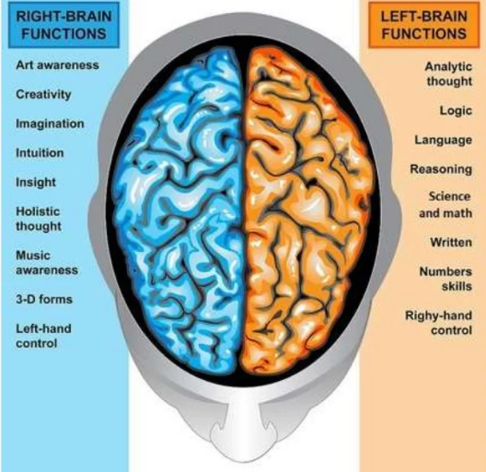
Brain – Functionality
Left verse Right Brain Functions
Source: Neuroscience as a learning theory by Hernan Sarasty.
https://www.slideshare.net/HernnSarasty/neuroscience-as-a-learning-theory#:~:text=NEUROSCIENCE%20OF%20LEARNING%202.%20DEFINITION%20Neuroscience%20is%20the,the%20actual%20physical%20processes%20that%20support%20such%20behavior.

Slide 8
Experts in your Courses
Want to take our students to deeper levels of understanding
(dare I say) Generate excitement
We want to impart our knowledge in a way the we feel has value and meaning to others
Object of their learning (or our teaching) anchored in holistic relatable context
Learning must resonate with their patterns of understanding
Retention comes through learning patterns we are willing to create

Slide 9
The Group’s Expertise
Explain the cadence of your course?
OR
How do you explain the rhythm of your class(es)?

Slide 10
Potential to Improve Learning
Reduce anxiety
Make space for contextually relevant connections
Be punctuated with a cadenza to increase students’ emotive responses or
As a pause for effect, with the intention of accentuating a complex or difficult concept
A slow cadence can create an environment that elicits reflection & meditation
Caution: If our students hear a chaotic, unstructured cadence, then the outcome of their learning will mirror that experience.

Slide 11
Summary
Cadence less about the knowledge we impart
About garnering the value of the experience on students’ development
Creating predictable pattern recognition and
Helps students see the path to new ways of understanding
Holistic interplay of the whole brain, enhanced through the cadence of lectures and
Creating space between for learning

Slide 12
Questions?
Mahsi
Merci
Thank you

