Slide 1
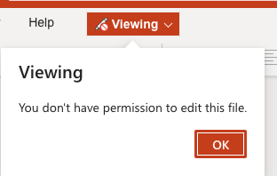
Customizing Blackboard Banner
A standard course template for all Northern College courses:
provides students with a consistent experience in terms of navigating their courses
reduces exertion to figure out where to find materials and tools with each course they start
can support persistence and satisfaction (by enabling focus on learning tasks, reducing confusion)
To customize the banner for your complete the following steps. (LINK to VIDEO)
1
Select Faculty Resources from the left menu bar.
2
Choose the Blackboard Banner Template link
3
Login in using your College username and password.
A PPT with the templates will open
You will have view only access

Slide 2
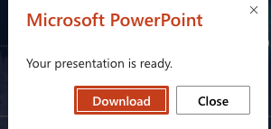
4
Choose File -> Save As from the top menu bar
Download a Copy of the Blackboard Banner Templates PPT to your computer
5
You may be prompted to Download the presentation.
6
Go to your downloads or view your downloads to find the file and open it

Slide 3
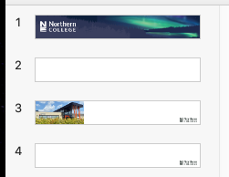
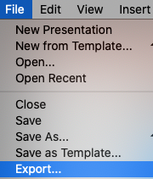
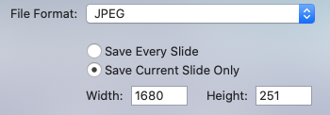
7
Choose one of the templates.
You can add your own text to the template with Northern College branding images provided (Step 8)
OR
Add a course appropriate image and titles (Steps 9a and 9b)
8
Add Text
Add the Course Name in the Title and the Course # in the Subtitle
Add Image and Text
9a
9a.
Download a high-quality course appropriate image from pixabay, unsplash or pexels.
9b.
Once the image is downloaded select the Add Image Icon.
Add Text
Add Image and Text
9b
Add Image and Text Example
From the PPT Menu Bar choose File -> Export
From the File Format Drop Down select JPEG
Select Current Slide Only
Make sure the Width and Height is 1680 x 251
10
11
12
13

Slide 4
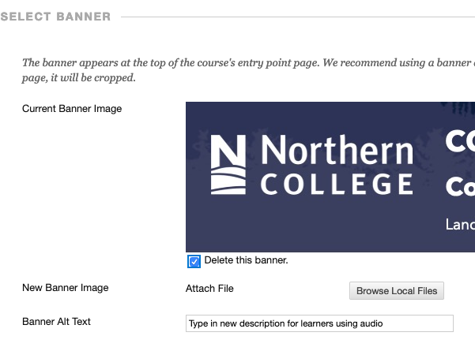
14
From the Blackboard Menu Bar Select Customization
Choose Teaching Styles
NOTE: Do not change the theme of the course – for branding purposes all NC courses will use the same theme.
15
16
Scroll down to Select Banner
Check the Delete this banner option
Browse to the new banner you have saved on your computer
Type in a new description for learners using audio
Click Submit
Select the Announcements Button to see view the new uploaded Course Banner
17
18
19
20
21

