Slide 1
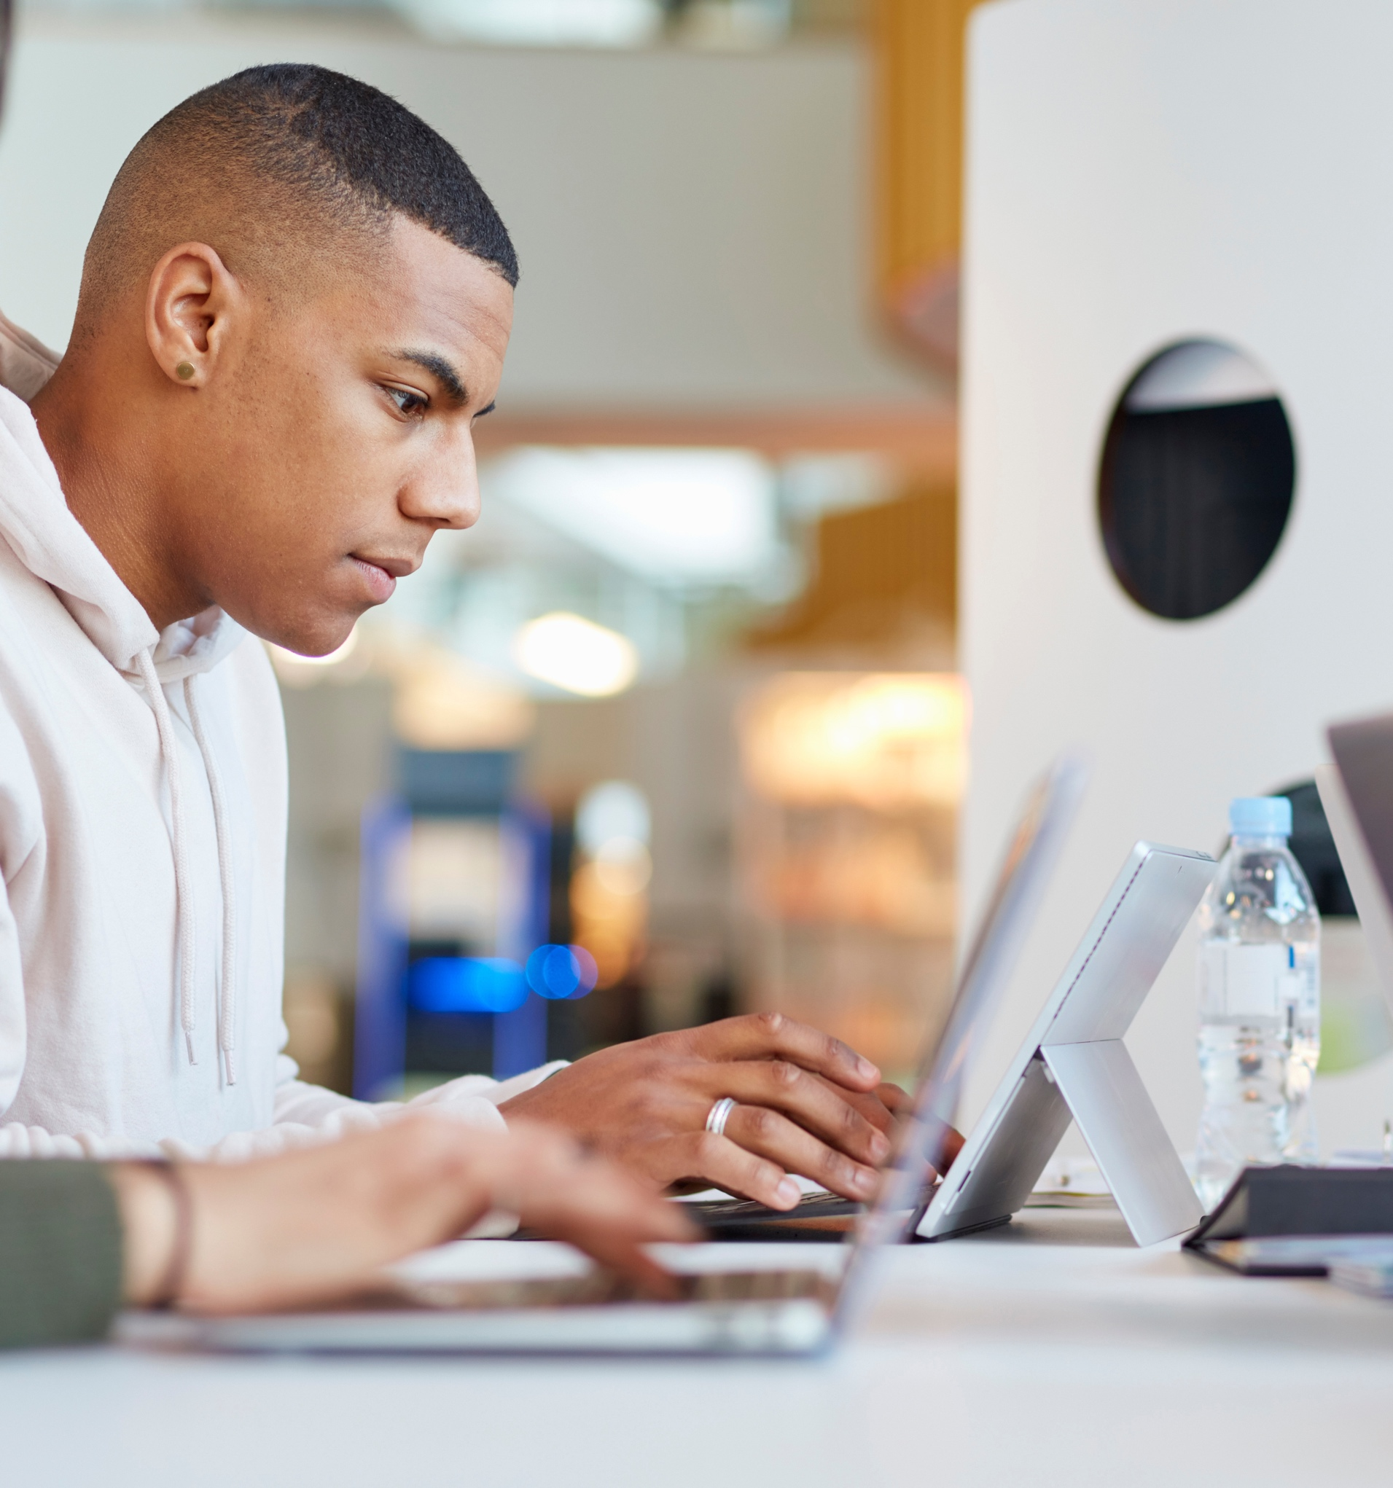
Why Connect?
Connect
Connect is your personalized digital learning platform that makes studying and getting work done easier and more convenient than ever.
Maximize your study time with a personalized learning path.
Save time – access assignments & learning tools in one place.
Achieve better grades & track your progress.
Learn online or offline, anytime, anywhere.

Slide 2
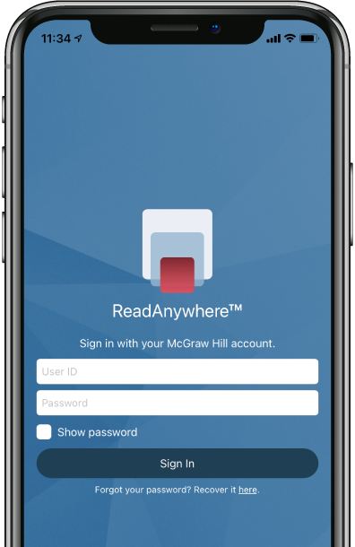

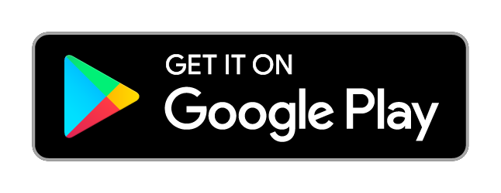
ReadAnywhere App
The FREE ReadAnywhere App makes it easy to read your Connect eBook on your smartphone or tablet so you can study anywhere, anytime.
Complete SmartBook assignments
Listen to your textbook with audio functionality
Sync assignments & notes
Download & read chapters
Work online or offline
Highlight and take notes
Download Now

Slide 3


How to Register
Go to your instructor’s Blackboard Ultra course and navigate to Course Content.
Click an assignment labeled “McGraw Hill”.
Click “Connect Quick Links”.
  If you already have a Connect account, enter your password.
  If you do not have a Connect account, complete the form, and click “CONTINUE”
Complete 1 of 3 registration options
  Connect Code
  Purchase Online
  Temporary Access
Confirm registration

Slide 4
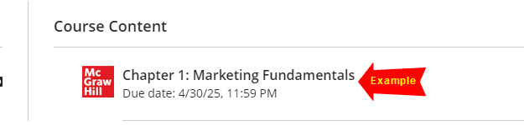
Getting Started
D2L
1. Go to your instructor’s Blackboard Ultra course, navigate to Course Content
2. Click an assignment labeled “McGraw Hill”.

Slide 5
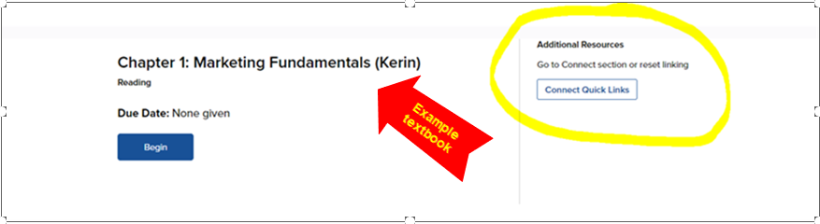
Getting Started
D2L
3. Click “Connect Quick Links”

Slide 6
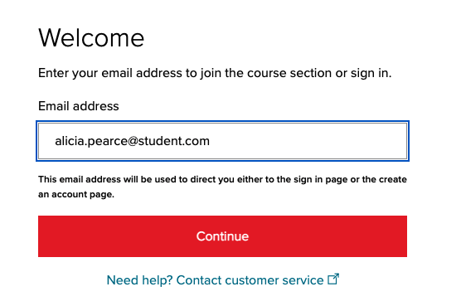
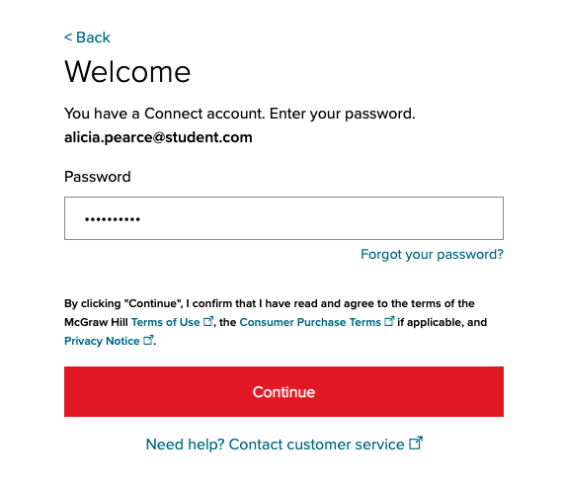
How to Register – Existing Account
D2L
Enter your student email and click “BEGIN”.
If you already have a Connect account, enter your password.

Slide 7
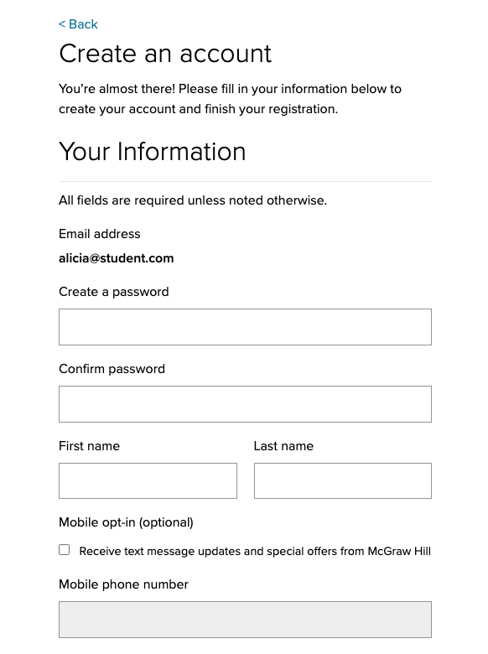
How to Register – New Account
D2L
Enter your student email and click “BEGIN”.
If you do not have a Connect account, complete the form, and click “CONTINUE”.

Slide 8
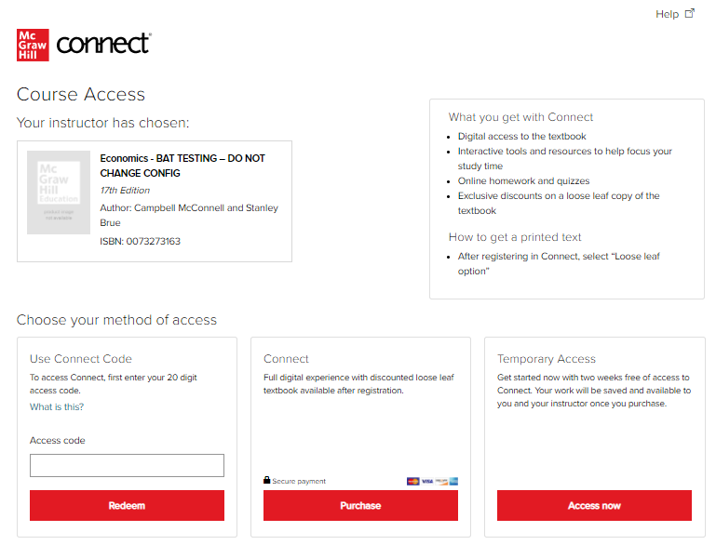
Step 4 - Registration
Step 5
You have three registration options.
Connect Code: Enter a Connect access code and click Redeem.
Purchase Online: Click Purchase to use a credit card or PayPal.
Temporary Access: Click Access Now for two-week temporary access.

Slide 9
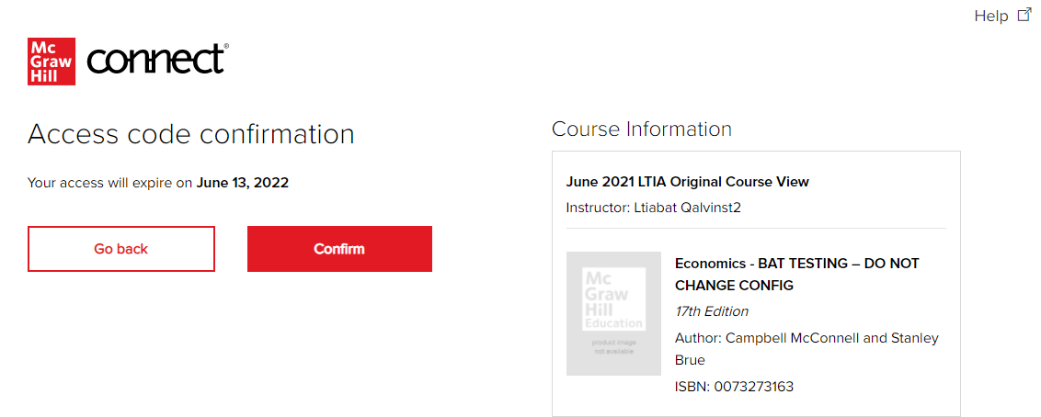
Step 5 - Click Confirm. You are now registered.
Step 6

Slide 10

Best Practices
Connect
Use Google Chrome as your internet browser
Clear your browser cache prior to the start of an assignment, simulation, quiz or exam.
Complete a Computer Compatibility Check.
Complete the assignment, simulation, quiz or exam on your laptop or desktop rather than a mobile device.
Reminders
Connect should be loaded on ONE session of your browser and only ONE tab within your browser.
Use an ethernet cable to directly connect your device to your internet modem for faster speeds.
Limit the number of applications running and devices connected to your wireless internet while completing your assignment.

Slide 11
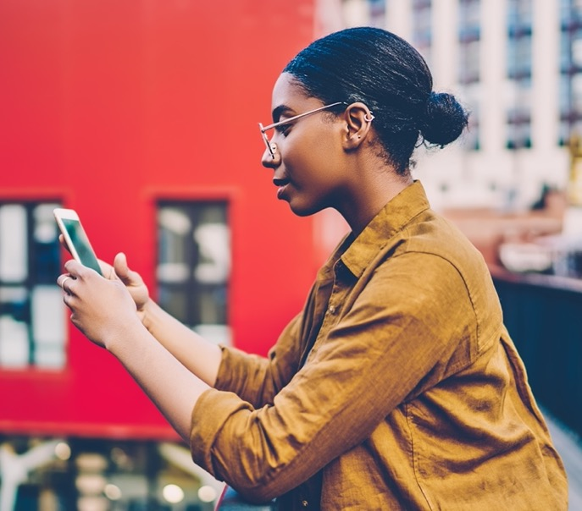
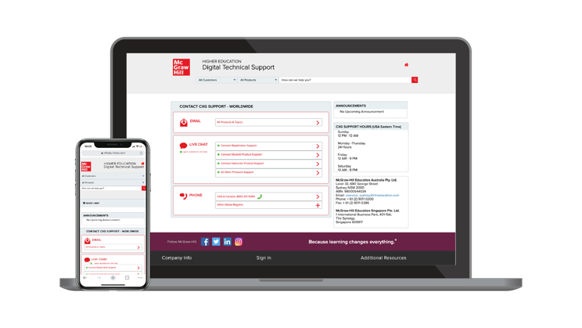
Accessibility & Support
Connect
Accessibility
Tech Support
If you have any questions or concerns about interacting with our products, please contact your institution’s Accessibility Office.
We’re here to help. If you need technical help with Connect, get in touch with our experts:
Phone: (800) 331 5094 (USA & Canada)
Web: Get in touch
FAQs & Support
Find helpful videos, articles and more about using Connect at: https://www.mheducation.ca/higher-education/learning-solutions/support-implementation/student-support​

