Slide 1
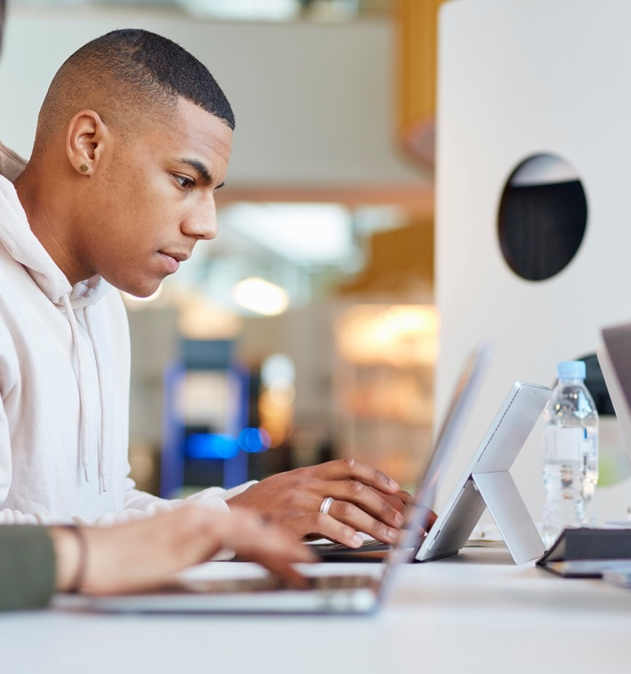
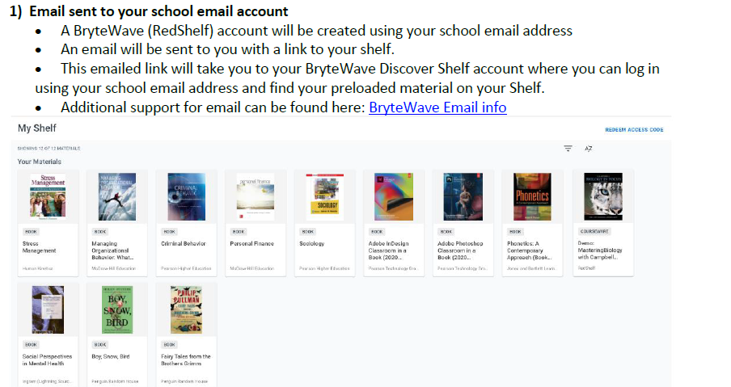
Accessing Your Brytewave (Redshelf) Perpetual Ebook
Perpetual ebook + Connect - reading practice for better comprehension and better grades on Day 1 of class
Connect is your personalized digital learning tool that makes studying and getting work done easier and more convenient than ever.
Through Connect you will have access to the eBook and your assignments.
Go to your Connect course URL and start getting a better grade today!
Connect
For Brytewave support, please contact the bookstore or visit: https://brytewavesolve.zendesk.com/hc/en-us/categories/360001627173-Student-Support

Slide 2

Why Connect?
Connect
Connect is your personalized digital learning platform that makes studying and getting work done easier and more convenient than ever.
Maximize your study time with a personalized learning path.
Save time – access assignments & learning tools in one place.
Achieve better grades & track your progress.
Learn online or offline, anytime, anywhere.

Slide 3
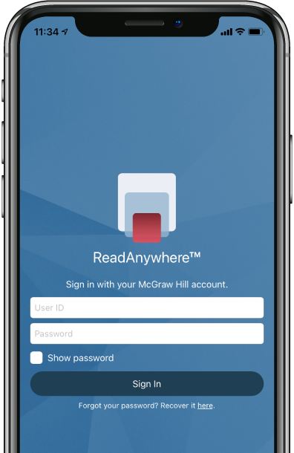

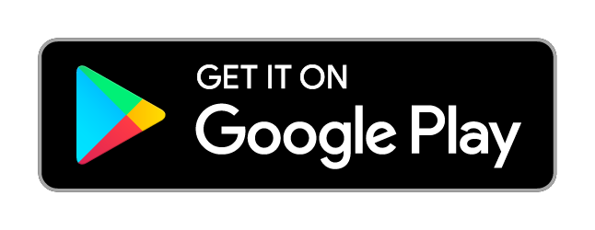
ReadAnywhere App
The FREE ReadAnywhere App makes it easy to read your Connect eBook on your smartphone or tablet so you can study anywhere, anytime.
Complete SmartBook assignments
Listen to your textbook with audio functionality
Sync assignments & notes
Download & read chapters
Work online or offline
Highlight and take notes
Download Now

Slide 4
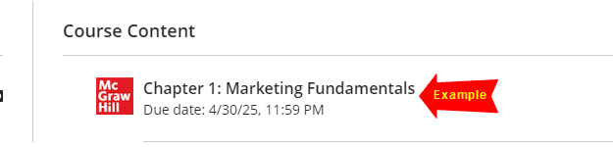
Getting Started
D2L
1. Go to your instructor’s Blackboard Ultra course, navigate to Course Content
2. Click an assignment labeled “McGraw Hill”.

Slide 5
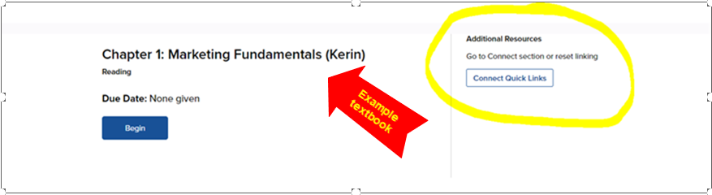
Getting Started
D2L
3. Click “Connect Quick Links”

Slide 6
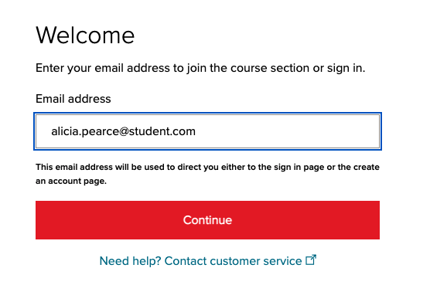
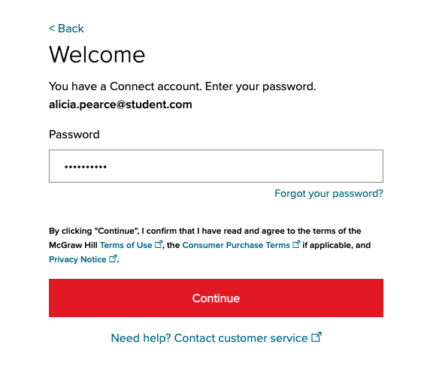
How to Register – Existing Account
D2L
Enter your student email and click “BEGIN”.
If you already have a Connect account, enter your password.

Slide 7
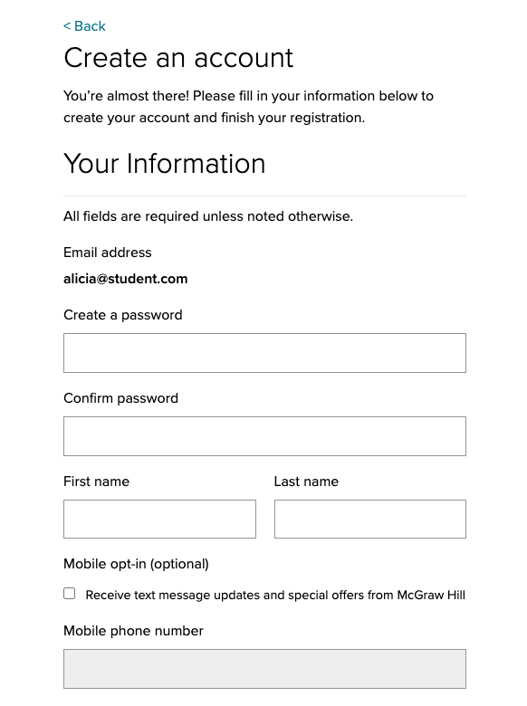
How to Register – New Account
D2L
Enter your student email and click “BEGIN”.
If you do not have a Connect account, complete the form, and click “CONTINUE”.

Slide 8
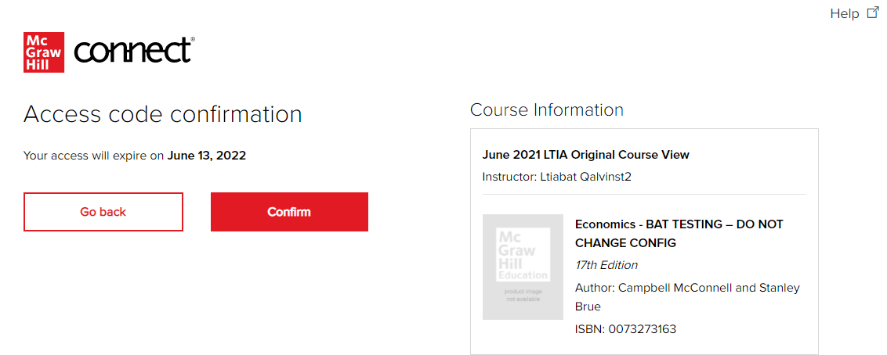
How to Register – Final Steps
Blackboard
4. Click Confirm. You are now registered.
If during the registration process you are requested to purchase or enter a code, please sign up using the free temporary access feature. Within your two-week trial, your access will be upgraded.

Slide 9

Best Practices
Connect
Use Google Chrome as your internet browser
Clear your browser cache prior to the start of an assignment, simulation, quiz or exam.
Complete a Computer Compatibility Check.
Complete the assignment, simulation, quiz or exam on your laptop or desktop rather than a mobile device.
Reminders
Connect should be loaded on ONE session of your browser and only ONE tab within your browser.
Use an ethernet cable to directly connect your device to your internet modem for faster speeds.
Limit the number of applications running and devices connected to your wireless internet while completing your assignment.

Slide 10

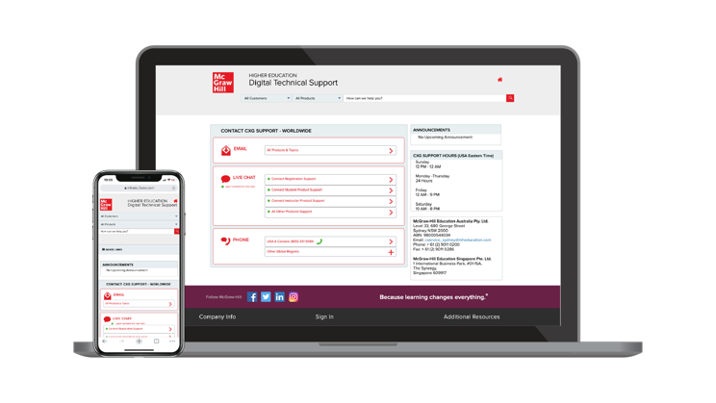
Accessibility & Support
Connect
Accessibility
Tech Support
If you have any questions or concerns about interacting with our products, please contact your institution’s Accessibility Office.
We’re here to help. If you need technical help with Connect, get in touch with our experts:
Phone: (800) 331 5094 (USA & Canada)
Web: Get in touch
FAQs & Support
Find helpful videos, articles and more about using Connect at: https://www.mheducation.ca/higher-education/learning-solutions/support-implementation/student-support​

